Slide 1
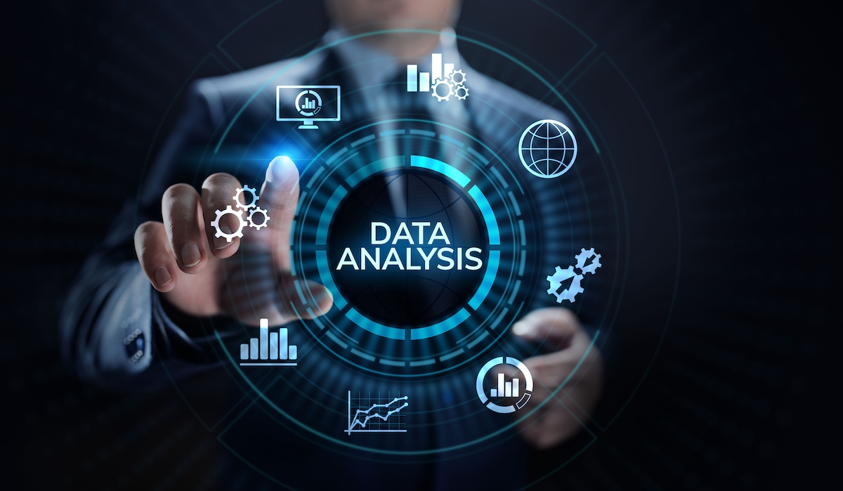

Slide 2
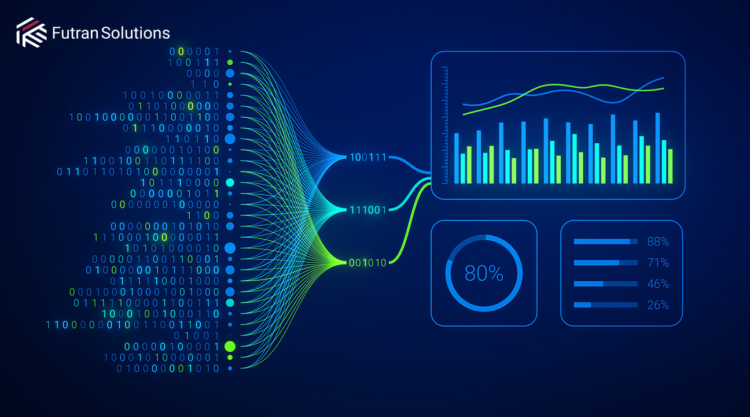
Data Analytics
Data analytics is the process of collecting, cleaning, transforming, and analyzing data to uncover useful insights, support decision-making, and drive strategic actions.

Slide 3
Data Analytics Workflow
Data Collection – Gathering raw data from databases, APIs, surveys, or sensors.
Data Cleaning – Handling missing values, duplicates, and outliers.
Data Transformation – Normalizing, aggregating, and encoding data.
Exploratory Data Analysis (EDA) – Visualizing data to find patterns.
Modeling & Analysis – Applying statistical or ML models.
Visualization & Reporting – Presenting insights through dashboards or reports.

Slide 4
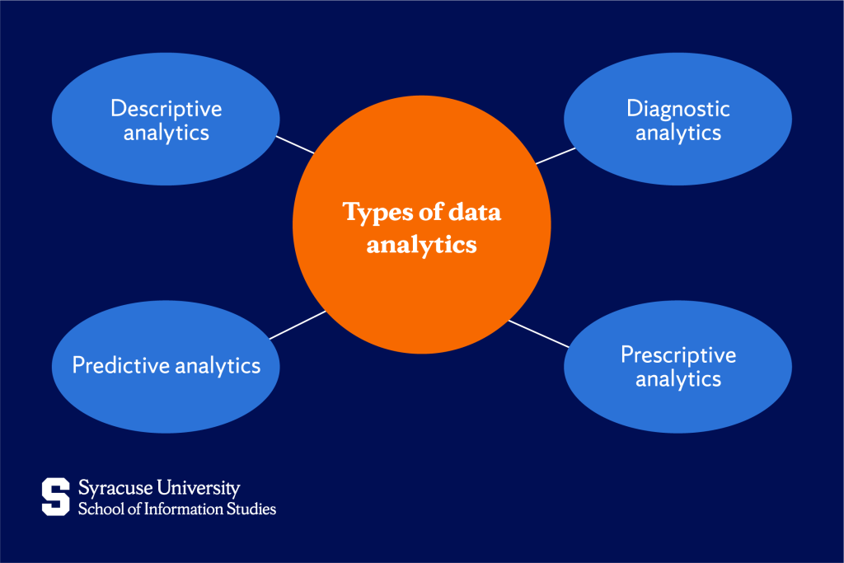
Types of Data Analytics
Descriptive Analytics – What happened? → Summarizes past data (e.g., sales reports, dashboards). Tools: Excel, Tableau
Diagnostic Analytics – Why did it happen? → Explores data to find causes or relationships (e.g., correlation, root cause analysis). Techniques: Data mining, drill-down analysis
Predictive Analytics – What will happen? → Uses statistics and machine learning to forecast outcomes. Tools: Python (Scikit-learn), R, SAS
Prescriptive Analytics – What should we do? → Suggests actions using optimization and simulation models. Tools: Python (SciPy, Pyomo), MATLAB, optimization solvers

Slide 5
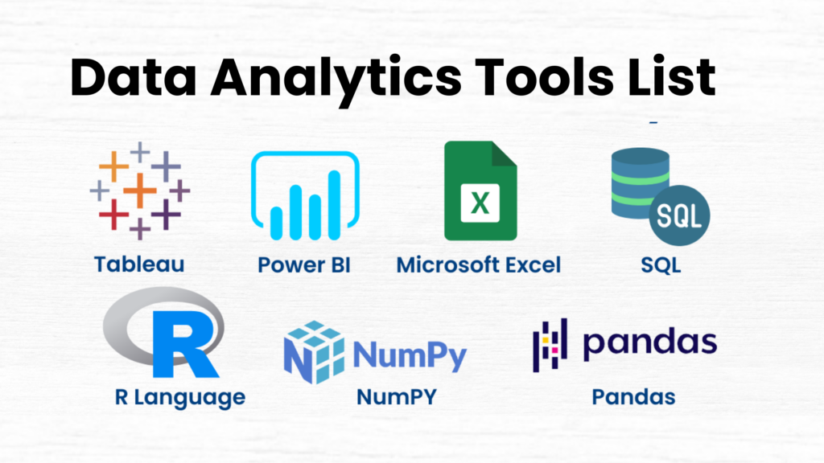
Common Tools & Languages
Programming: Python, R, SQL
Visualization: Tableau, Power BI, Matplotlib, Seaborn
Databases: MySQL, PostgreSQL, MongoDB

Slide 6
Basic requirements for data analytics
Data
You can’t do analytics without data — it’s the foundation.
Sources: Databases, Excel sheets, APIs, websites, sensors, surveys, etc.
Types of data:
Structured: Tables, spreadsheets (rows and columns)
Unstructured: Text, images, videos
Semi-structured: JSON, XML

Slide 7
Basic requirements for data analytics
2. Tools & Software
You’ll need tools to store, clean, and analyze data. Common tools include:
Data Storage: Excel, SQL databases (MySQL, PostgreSQL)
Data Cleaning & Analysis: Python (Pandas, NumPy), R, Excel
Data Visualization: Power BI, Tableau, Matplotlib, Seaborn
Big Data (for large-scale analytics): Apache Spark, Hadoop

Slide 8
Basic requirements for data analytics
3. Technical Skills
Essential skills for a data analyst include:
Excel: Basic formulas, pivot tables, charts
SQL: Querying and managing databases
Python or R: Data manipulation, analysis, and visualization
Statistics & Math: Mean, median, standard deviation, probability, hypothesis testing
Data Visualization: Creating clear and informative charts and dashboards

Slide 9
Basic requirements for data analytics
4. Understanding of Business / Domain Knowledge
Analytics is useful only when it solves real problems. You should understand:
The goals of the business (e.g., improve sales, reduce costs)
The key metrics (KPIs) that matter-a quantifiable measure used to track progress toward a specific business objective.
The context behind the data

Slide 10

Basic requirements for data analytics
6. Analytical Thinking
You need to:
Ask the right questions
Identify patterns and trends
Draw logical conclusions from data
Communicate insights clearly

Slide 11
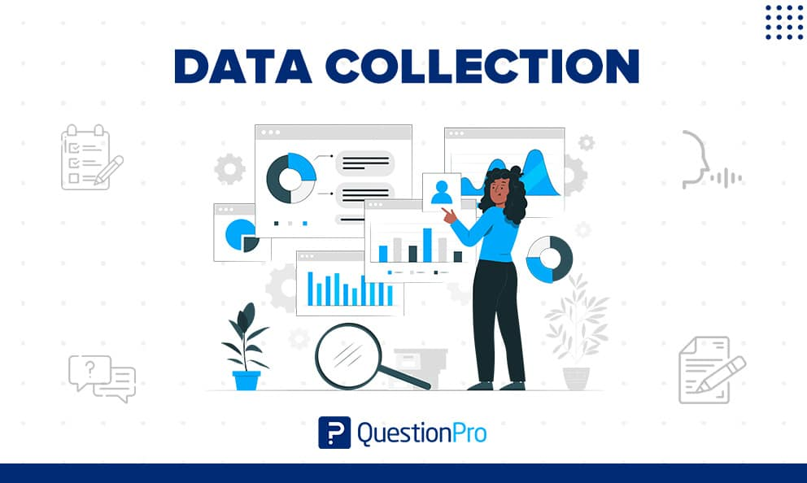

Slide 12
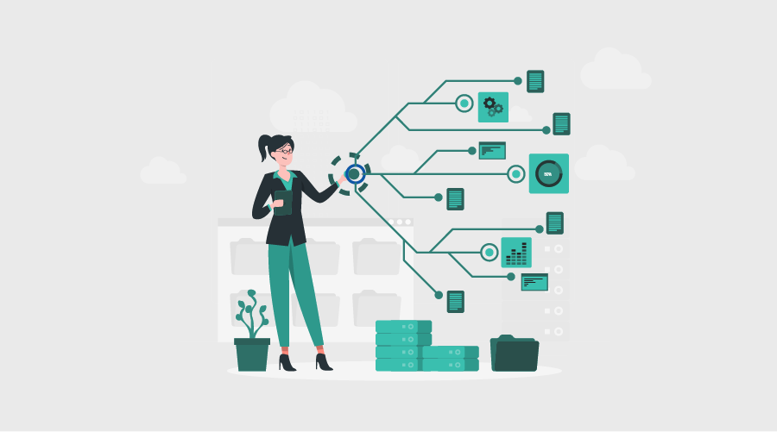
Data collection and its types
1. Primary Data Collection
Data collected first-hand specifically for your analysis or research.
a. Surveys & Questionnaires
Online forms, polls, feedback forms
Useful for large samples and quantifiable insights
b. Interviews
Structured, semi-structured, or unstructured
Generates deep, qualitative insights
c. Observations
Watching behaviors, processes, interactions
Can be direct (in person) or indirect (CCTV, system logs)
d. Experiments
Controlled testing (A/B testing, usability tests)
Helps determine cause-and-effect relationships
e. Focus Groups
Small group discussions
Useful for testing product ideas, opinions, motivations

Slide 13
Data collection and its types
2. Secondary Data Collection
Uses data that is already existing.
Examples:
Government databases
Corporate reports
Industry research, journals
Historical datasets
Third-party analytics platforms (e.g., Google Analytics, Kaggle datasets)
Use this when primary collection is costly or unnecessary.

Slide 14
Data collection and its types
3. Automated / Digital Data Collection
Collected automatically from digital systems.
a. Web Analytics
Stream data
Traffic logs
Customer purchase paths
b. Sensor / IoT Data
Temperature, motion, GPS, machine status
c. System Logs & Machine Data
Server logs, error logs, application logs
d. API Data Collection
Pulling data from online platforms through APIs (e.g., Twitter API, financial market APIs)

Slide 15
Data collection and its types
4. Transactional Data Collection
Data captured from business transactions, such as:
Sales receipts
Online orders
Banking transactions
Inventory updates
This is common in retail, finance, and supply chains.
✅ 5. Social Media & User-Generated Data
Collected from:
Social media posts
Comments & reviews
Likes, shares, engagement levels
Useful for sentiment analysis and trend detection.

Slide 16
Data collection and its types
6. Big Data Collection
Massive, fast-moving data from:
Streaming platforms
Sensors & IoT
Large-scale web logs
Cloud apps generating real-time data Uses technologies like Kafka, Hadoop, Spark.
Summary Table
Data Type | Example | Best Use
Primary | Surveys, interviews | Fresh insights, specific research questions
Secondary | Government reports | Cost-effective, historical trends
Digital/Automated | Web logs, APIs | Real-time analytics
Transactional | Sales records | Business intelligence
Social Media | Tweets, reviews | Sentiment & trend analysis
Big Data | IoT, streaming | Predictive modeling & automation

Slide 17
Challenges in data collection
✅ 1. Data Quality Issues
Incomplete data
Inaccurate or inconsistent responses
Outdated information
Human errors in manual entry
✅ 2. Privacy and Ethical Concerns
Collecting sensitive personal data
Compliance with DPDP etc.
Need for consent and secure storage
✅ 3. Lack of Proper Tools or Technology
Limited access to data collection software
Incompatible systems
Difficulty in integrating data from multiple sources

Slide 18
Challenges in data collection
✅ 5. Respondent-Related Issues (for primary data)
Unwilling or unresponsive participants
Biased answers
Misunderstanding questions
Low survey completion rates
✅ 6. Data Overload (Too Much Data)
Hard to process or clean large volumes
Storage issues
Noise that reduces analysis accuracy
✅ 7. Inconsistent Data Formats
Different units, file types, naming conventions
Hard to merge or compare datasets

Slide 19
Challenges in data collection
✅ 8. Accessibility Problems
Restricted or paid datasets
Organizational silos
Missing permissions
✅ 9. Technical and Security Challenges
Network failures during digital collection
Risk of cyberattacks or data breaches
✅ 10. Real-Time Data Collection Issues
Latency
Hardware reliability (sensors/IoT)
Stream interruptions

Slide 20
Ethics in Data Analytics
Ethics in data analytics refers to the responsible, fair, and transparent handling of data throughout its lifecycle—collection, storage, analysis, and sharing
✅ 1. Privacy
Respecting user privacy and personal boundaries
Collecting only the data that is necessary
Avoiding intrusive or hidden data collection
Example: Not collecting users’ locations unless required.
✅ 2. Informed Consent
Users must know what data is being collected
Consent must be clear, voluntary, and revocable
No vague or deceptive data policies
Example: Apps showing clear permission requests.

Slide 21
Ethics in Data Analytics
✅ 3. Data Security
Protecting data from unauthorized access
Using encryption, secure storage, and strong access controls
Ensuring safe transfer of data
Example: Encrypting user data stored on servers.
✅ 4. Transparency
Being open about how data is used, stored, and analyzed
Making algorithms or decisions explainable
Disclosing data sources and limitations
Example: Explaining how a recommendation system works.

Slide 22
Ethics in Data Analytics
✅ 5. Fairness & Avoiding Bias
Ensuring that data and algorithms do not discriminate
Avoiding biased training datasets
Testing for unequal impacts on groups
Example: Preventing credit scoring algorithms from discriminating against minorities.
✅ 6. Accountability
Organizations must take responsibility for data misuse
Clear governance, auditing, and ethical review processes
Defining who is accountable for decisions driven by analytics
Example: Holding a team accountable for incorrect predictions that cause harm.

Slide 23
Ethics in Data Analytics
✅ 7. Data Accuracy & Integrity
Ensuring data is correct, complete, and reliable
Avoiding manipulation of data for desired outcomes
Maintaining transparency about errors
Example: Verifying data sources before analysis.
✅ 8. Purpose Limitation
Using data only for the purpose it was collected for
Not misusing data for unrelated or harmful activities
Example: Not selling customer data to third parties without permission.

Slide 24
Ethics in Data Analytics
✅ 9. Avoiding Harm
Ensuring analytics does not cause psychological, financial, or social harm
Considering the wider impact of analytics-driven decisions
Example: Avoiding analytics that unfairly excludes people from services.
✅ 10. Ethical Use of AI & Automation
Making automated decisions accountable
Avoiding black-box models that cannot be explained
Monitoring AI systems continuously for harmful behavior

